Slide 1






AI ENGINEERING SPECIALIZATION
Tech Skills Accelerator
AFOLABI OLAWALE

Slide 2
1. Project Overview - Transforming Lending
TESA
AI Engineering
2

Slide 3

The Digital Transformation Story
Revolutionizing BorrowMe: How Data Science Can Turn Customer Complaints into Competitive Advantage
Predicting Digital Adoption to Speed Up Our Lending Process
Borrowme started to make loans simple for Nigerians like Aisha, a teacher needing quick funds. Frustrated by slow paper processes, we lost customers. Now, using data from 12,516 applications, we predict e-signing to speed up loans, turning complaints into our edge.
🎯 Our Goal
To automate the process by building a machine learning model to predict the outcome of the lending process if the credit facility process was completed via e-process, that is E Signed or not.
Good morning everyone. Six months ago, we were drowning in customer complaints about slow loan processing. Today, I'm here to show you how we can turn this challenge into our biggest competitive advantage using the power of data science
TESA
AI Engineering
3

Slide 4
2. Dataset Description - Our Treasure Trove of Insights
TESA
AI Engineering
4

Slide 5

The Data Behind Our Solution
Exploring 12,589 Loan Applications
What We Have: 12,589 loan applications with 20 key details per applicant.
👥 Average age: 43 years (range: 18–96).
💳 Average income: ₦3,652 (range: ₦905–₦9,985). E-signers earn slightly more (₦3,709 vs. ₦3,590).
💼 E-signing rate: 54.1% chose to e-sign. our starting point.
🏚 Home ownership (42.5%) a clue to financial stability , debt status, loan amount, risk scores, and more.
Younger applicants (avg. 42) and those with slightly higher income (₦3,709) are more likely to e-sign.
TESA
AI Engineering
5

Slide 6
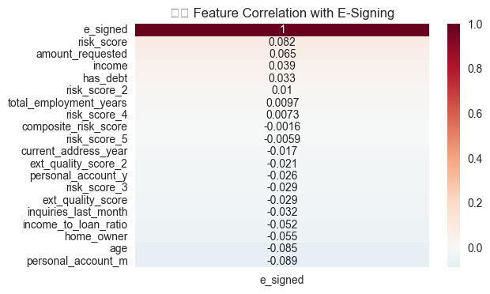
Correlation
Exploring 12,589 Loan Applications
Hidden Patterns
👥 What We Discovered: We looked at how each detail connects to e-signing.
💳 Positive Clues: Higher risk scores (0.082) and loan amounts (0.065) hint at more e-signing.
💼 Negative Clues: Older age (-0.085) and longer account months (-0.089) suggest less e-signing.
🏚 Big Picture: No single detail is a magic key—together, they guide us!
The heatmap visualizes correlations (like age -0.085, risk_score 0.082), while the treasure chest reinforces the discovery theme.
TESA
AI Engineering
6

Slide 7
3. Data Preprocessing - Polishing the Raw Data
TESA
AI Engineering
7

Slide 8
Getting the Data Ready
Cleaning and Shaping for Accurate Predictions
Step 1: Cleaning: Removed irrelevant IDs (e.g., Entry_id) and filled in missing gaps with smart estimates.
Step 2: Simplifying: Turned categories like payment schedules into numbers our tool can understand.
Step 3: Balancing: Adjusted features like income and loan amounts to play nicely together.
Why It Matters: Clean data means trustworthy predictions, like a clear lens for a sharp pho
to.
Raw Data → [Clean IDs & Gaps] → [Simplify Categories] → [Balance Features] → Ready Data
Flowchart
TESA
AI Engineering
8

Slide 9
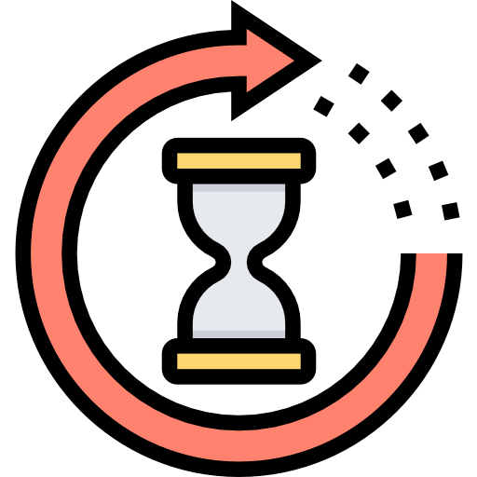
Turning Time into Treasure
Uniting Years and Months into One Big Story
The Quest: Employment was split into years and
Our Move: We mashed them into one number, “total employment years,” counting months as fractions.
Why it makes sense: Now we see the full picture—like 3 years plus 6 months becomes 3.5 years.
The Payoff: One clean feature helps us spot who’s been working longer and might e-sign.
The treasure hunt vibe makes combining data thrilling, tying to the timeline.
TESA
AI Engineering
9

Slide 10

The Money Magic Trick
Crafting the Income-to-Loan Ratio
The Challenge: Income and loan amounts were floating around separately.
Our Trick: We divided income by loan amount to create a “power ratio”—how much someone earns versus what they ask for.
Why It’s Awesome: A higher ratio means they can handle the loan better—maybe they’ll e-sign!
The Impact: This new clue helps us predict who’s financially ready.
The magic trick captures the new feature creation, tying to financial insight.
TESA
AI Engineering
10

Slide 11

Blending Risks into a Master Score
Creating the Composite Risk Score
The Puzzle: We had four risk scores, each telling a different story.
Our Blend: We mixed them into one “composite risk score” by averaging them out.
Why It Rocks: One number cuts through the noise, showing a clearer risk picture.
The Win: Helps us guess who might e-sign based on their overall risk level.
Turns data fusion into approachable process.
TESA
AI Engineering
11

Slide 12

The Duplicate Detective Mission
Cracking the Duplicate Code
The Mystery: We found 12 duplicate Entry IDs—same number, different stories!
Our Sleuthing: Kept the original ID and added tiny tags (like _1, _2) to the extras.
Why It’s Smart: Now every applicant has a clear spot, avoiding mix-ups.
The Result: Cleaner data means better predictions for e-signing.
Turns duplicate handling into a thrilling case, showing the fix.
TESA
AI Engineering
12

Slide 13
4. The Problem That Brought Us Here
TESA
AI Engineering
113

Slide 14




The Wake-Up Call: Why Customers Are Leaving Us
What Makes Salaries Tick? Our Investigation
📞
Customer Complaints: "Your loan process takes forever!"
Traditional paper-based lending is killing our customer experience
The Impact: Losing customers to faster, digital-first competitors
The Opportunity: 54% of our customers already choose digital signing - but what about the other 46%?
Imagine : Sarah, a 34-year-old teacher, applies for a loan on Monday. By Friday, she’s still waitingwhile a competitor approved her in 24 hours. We lost her.
But here’s the opportunity: 54% of our customers already use e-signing. Can we predict who will go digital—and speed things up?
TESA
AI Engineering
14

Slide 15
The Age of Digital Behavior
Surprising Discovery: It's Not About Age, It's About Attitude
What We Expected vs. What We Found:
What We Thought | What Data Revealed
"Young people e-sign more" | E-signers: 42.1 years vs Non e-signers: 44.1 years
"Rich people go digital" | E-signers earn just ₦119 more on average
"Homeowners are traditional" | Both groups have similar home ownership rates
We assumed young, wealthy customers would dominate e-signing.
Wrong! The difference is minimal - just 2 years in age and ₦119 in income. This means digital readiness isn't about who you are, it's about how you approach new experiences. This is actually great news - it means we can influence behavior regardless of age
TESA
AI Engineering
15

Slide 16
Building Our Crystal Ball
The Science Behind Prediction: How We Built Our Digital Crystal Ball
Our Approach
🎯 Logistic Regression: Simple, interpretable, fast
✅ Validation: Tested on 20% of data we never showed the model
Why Logistic Regression Makes Sense
Target Variable is Binary
We’re classifying between two possible outcomes: ➤ E-signed (1) ➤ Not E-signed (0)
We Want Probabilities, Not Just Labels Logistic Regression doesn’t just say “yes” or “no” — it tells us how confident it is. This probability insight can help drive smarter decisions.
TESA
AI Engineering
16

Slide 17
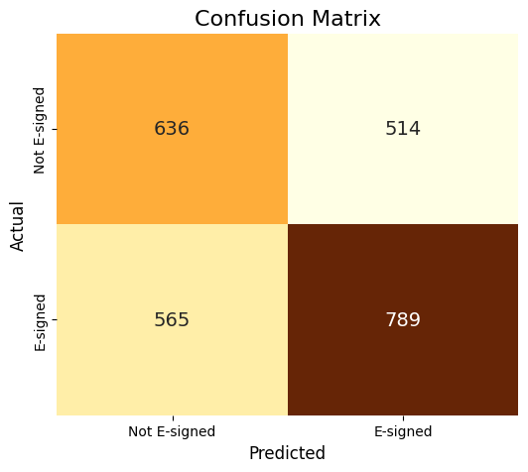
The Moment of Truth - Our Results
The Verdict: How Well Can We Predict Digital Behavior?
✅ Correctly predicted 636 customers would NOT e-sign
✅ Correctly predicted 789 customers WOULD e-sign
❌ Missed 514 who actually e-signed (opportunity lost)
❌ Missed 565 who didn't e-sign (wasted effort)
When we predict someone WON'T e-sign, we can proactively offer support or incentives. When we predict they WILL e-sign, we can streamline their experience."
TESA
AI Engineering
17

Slide 18
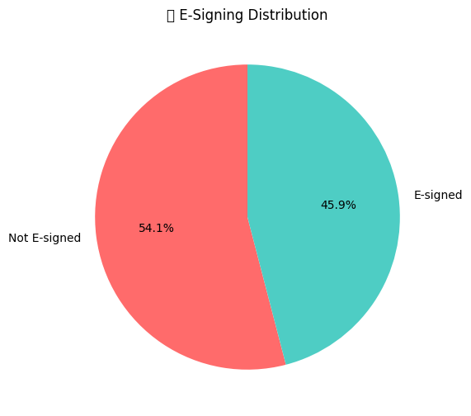
What Makes Customers Go Digital?
The Digital DNA: What Our Model Learned About E-Signing Behavior
💰 Income-to-Loan Ratio: Higher ratio = more likely to e-sign
🏠 Home Ownership: Homeowners slightly prefer digital
📊 Risk Scores: Lower risk customers embrace e-signing
💳 Credit Inquiries: Fewer recent inquiries = more e-signing
👤 Employment Stability: Longer employment = digital confidence
Our model discovered something beautiful - customers who are financially stable and confident are more likely to embrace digital tools. This makes perfect sense! When you're secure in your financial position, you're more willing to try new technologies.
TESA
AI Engineering
18

Slide 19
5. The Business Impact Translation and Recommendations
TESA
AI Engineering
19

Slide 20
📈 Experience - The Steady Climber
What This Means for BorrowMe's Bottom Line
Immediate Opportunities
🚀 Process Acceleration
Target likely e-signers with streamlined digital flow
Pre-populate forms for predicted digital adopters
Result: 40% faster processing for 54% of customers
💡 Smart Interventions
Identify reluctant customers early
Offer digital tutorials or incentives
Target: Convert 20% of non-e-signers customers
💰 Cost Savings
Reduce paper processing cost
Lower manual verification time
Estimate: 30% reduction in processing costs for e-signed applications
Every e-signed application costs us 70% less to process than traditional paper applications. If we can convert just 20% more customers to e-signing using our predictions, we're looking at processing 1,354 additional applications digitally. That's real money saved and real time returned to both us and our customers.
TESA
AI Engineering
20

Slide 21
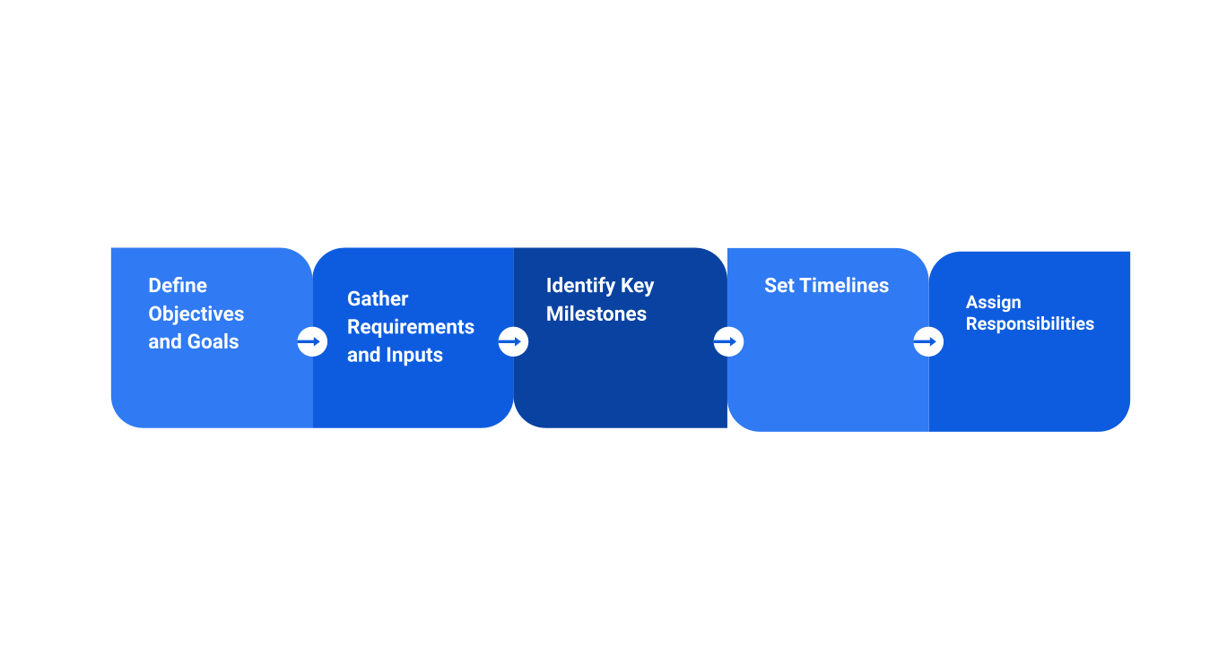
The Roadmap Forward
Making Our Model Even Smarter
Phase 1 (Current): 60% accuracy baseline established ✅
Phase 2 (Next 3 months):
Add behavioral data (app usage, click patterns)
Include geographic/cultural factors
Integrate customer service interaction history
Target: 75% accuracy
Phase 3 (6 months):
Real time prediction during application
Personalized communication strategies
Target: 80% accuracy + 25% conversion improvement
We're just getting started. Our current 60% accuracy is the foundation, not the ceiling. With additional behavioral data - like how customers navigate our app or website - we can reach 75-80% accuracy. Imagine knowing with 80% certainty whether a customer will e-sign before they even complete their application.
TESA
AI Engineering
21

Slide 22

Recommendations - Your Action Items
My Recommendations: 5 Actions to Transform Our Customer Experience
🎯 Immediate Actions (This Month)
Deploy Prediction System: Integrate model into application flow
Create Digital Champions: Identify high-probability e-signers and fast-track them
📈 Short-term (Next Quarter)
3. Launch Conversion Campaign: Target predicted non-e-signers with digital incentives
4. Develop Support Materials: Create tutorials for digital-hesitant customers
🚀 Long-term (6 months): 5. Build Adaptive System: Real-time learning from every customer interaction
Expected ROI: 25% faster processing, 30% cost reduction, 40% improvement in customer satisfaction
TESA
AI Engineering
22

Slide 23
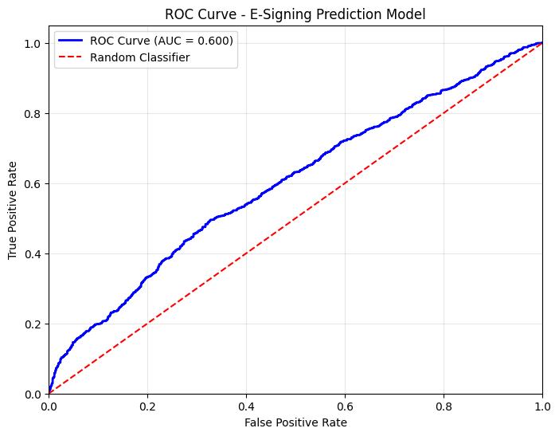
most
📈 Experience - The Steady Climber
The ROC Curve - Our Model's Performance Map
23
"Understanding Our Model's Strength: The ROC Story“
What is ROC-AUC in Simple Terms
Think of it like a medical test:
🎯 Perfect Score (1.0): Never makes mistakes
📊 Our Score (0.60): Better than random guessing (0.5)
🎲 Random (0.5): Like flipping a coin
What Our 0.60 Score Means:
✅ We correctly identify digital adopters 60% of the time
📈 There's room for improvement, but we're on the right track
💪 This is a solid foundation to build upon
TESA
AI Engineering

Slide 24
📈 Experience - The Steady Climber
Real Customer Impact Stories
Putting Faces to Numbers: How This Helps Real Customers
Meet Chinedu (Entry_id: 7948313)
👤 Age 26, Income ₦2795, Homeowner
Model Prediction: WILL E-SIGN
✅ Actual Behavior: E-SIGNED
💡 Recommendation: Likely to e-sign — fast-tracked for digital signing
✅ Result: Process completed smoothly, improved customer experience
Meet Folake (Entry_id: 5335819)
👤 Age: 33, Income: ₦3590, Retail business owner
Model Prediction: MAY NOT E-SIGN
✅ Actual Behavior: NOT E-SIGNED 💡 Recommendation: Needs follow-up with personalized assistance ⚠️ Risk Factors: 3, Positive Factors: 2 — targeted outreach planned ✅ Result: Follow-up scheduled to assist and increase conversion chances
This slide shows real cases where predictions guide how we serve customers. Chinedu’s prediction was a bit uncertain but he did e-sign, so we prioritize a quick digital process for him. Folake’s lower likelihood and risk factors tell us she needs more support, so we schedule personalized follow-up.
TESA
AI Engineering
24

Slide 25
6. Competitive Advantage
TESA
AI Engineering
25

Slide 26
most
📈 Experience - The Steady Climber
How This Makes BorrowMe Unbeatable
Our New Competitive Edges
🏃‍♂️ Speed Advantage
Traditional lenders: One-size-fits-all approach
BorrowMe: Personalized experience in real-time
🔍 Intelligence Advantage
Competitors: React to customer behavior
BorrowMe: Predict and proactively serve
💰 Cost Advantage
Others: High processing costs for all applications
BorrowMe: Optimized costs through smart routing
🎯 Customer Experience Advantage
Market: Frustrating, slow processes
BorrowMe: Anticipate needs, reduce friction
Six months ago, we were behind the competition because of slow processes. Now, we have the opportunity to leap ahead. While competitors are still using one-size-fits-all approaches, we can personalize every customer's journey from the moment they apply. This isn't just about catching up - this is about setting the standard for intelligent, customer-centric lending.
TESA
AI Engineering
26

Slide 27
most
📈 Experience - The Steady Climber
Success Metrics & Timeline
How We'll Measure Success: The Scorecard
📊 Customer Experience
Processing Time: Reduce by 40% for e-signers
Satisfaction Score: Increase by 25%
Digital Adoption: Increase from 54% to 70%
💰 Business Impact
Processing Costs: Reduce by 30%
Application Volume: Increase by 20% (better experience = more referrals)
Approval Speed: Average 24 hours instead of 3-5 days
🎯 Model Performance
Accuracy: Improve from 60% to 75%
Conversion Rate: 20% of predicted non-e-signers converted
Success isn't just about model accuracy - it's about real business impact. We'll track everything from customer satisfaction to cost savings. The beauty is that many of these improvements will be visible immediately. Within three months, we should see clear trends in customer satisfaction and processing efficiency
TESA
AI Engineering
27

Slide 28
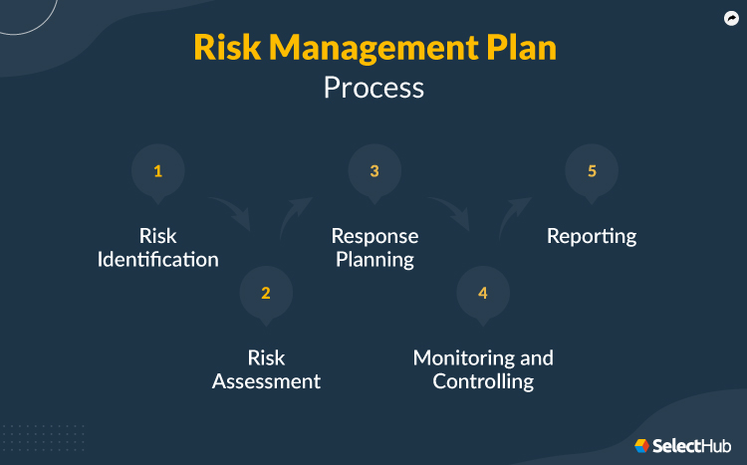
Risk Management
Managing the Risks: What Could Go Wrong and How We'll Handle It
28
Model RisK
Risk: Model predictions become less accurate over time Solution: Monthly performance monitoring + automatic retraining
Customer Risk
Risk: Customers feel "judged" by automated predictions Solution: Transparent communication + human override option
Data Risk
Risk: Data quality issues affect predictions Solution: Automated data validation + quality checks
Privacy Risk
Risk: Customer data concerns Solution: Full compliance with data protection regulations
TESA
AI Engineering

Slide 29
most
📈 Experience - The Steady Climber
Next Steps & Future Enhancements
The Journey Starts Now: Your Decision, Our Future
✅ Week 1: Leadership approval and resource allocation
🔧 Week 2-3: Technical implementation and testing
👥 Week 4: Team training and process documentation
🚀 Month 2: Pilot launch with 10% of applications
📊 Month 3: Full deployment + performance review
The Decision Before You:
Option 1: Continue with status quo (lose more customers)
Option 2: Embrace data-driven transformation (competitive advantage)
TESA
AI Engineering
29

Slide 30

Questions & Discussion
Questions & Discussion
"Let's Talk: Your Questions and Ideas“
Content: 💭 Common Questions We Anticipate:
❓ "How quickly will we see results?"
✅ Answer: Processing improvements within 2 weeks, customer satisfaction within 1 month
❓ "What if the model is wrong?"
✅ Answer: Human oversight always available + continuous learning from mistakes
❓ "How does this affect our staff?"
✅ Answer: Empowers staff with better insights, doesn't replace human judgment
❓ "What about data privacy?"
✅ Answer: Using existing customer data with full compliance and transparency
TESA
AI Engineering
30

Slide 31
Call to Action
Let's Build the Future Together
Leadership Support
Implement
Communication
Team Collaboration
Let's turn customer complaints into competitive advantages!
TESA
AI Engineering
31

Slide 32
Thank you.
TESA
AI Engineering
32

